Slide 1

MES 503 Lab 8
Kayla Blincow, PhD

Slide 2

Announcements
Lab Assignment 2 graded
New lab assignment posted

Slide 3

Transforming Data: Why do we do it?

Slide 4
Transforming Data: Why do we do it?
To avoid violating assumptions…
To even out the variance if the assumption of homoscedasticity is violated
To normalize a variable if the assumption of normality is violated
To linearize model if variable looks non-linear
Reduce the impact of outliers

Slide 5
Let’s Talk Transformations
Transformation changes the scale of the data but doesn’t change the relative ordering of observations
  E.g. log10() turns values such as 1,10, and 100 into 0, 1, 2 -> the observations are still in the same order, but large values have less influence
This is okay because typically we are interested in the underlying pattern, rather than the original measurement scale itself

Slide 6
Let’s Talk Transformations
This is NOT changing the data to get the result you want!
The goal of a transformation is not to make the data look better—it is to make the statistical model better suited to the data.

Slide 7
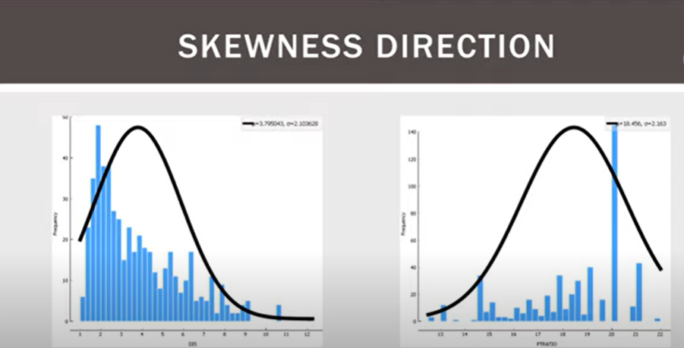
Transforming Data
RIGHT
LEFT

Slide 8
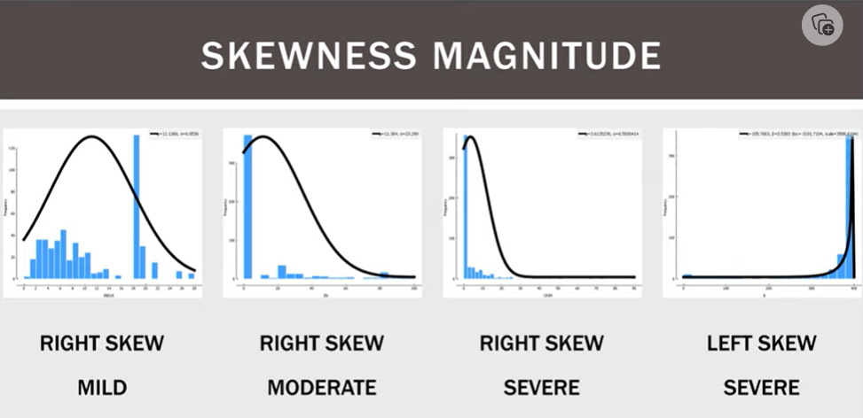
Transforming Data

Slide 9
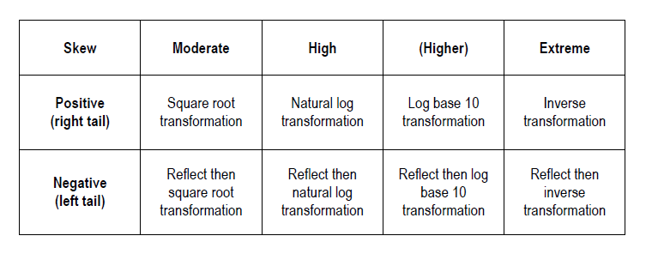
Transforming Data: Which one to use?
Reflect: flips the distribution, necessary for left skewed data
  (MAX + 1) – X
FYI: log() in R is natural log →ln() is the same
  log10() gives log base 10

Slide 10
Let’s Talk Transformations
When presenting results of a test performed on transformed data:
State that the data were transformed
Report the results of the statistical test normally, but make sure you are very clear what your response variable is (log transformed?)
  Leave no doubt about whether you are talking about raw or transformed data
Be careful when interpreting effect size
  You might need to back transform.
Present figures in a way that helps the reader understand the system (not necessarily the statistics)
  You may want to show the raw data in figures because the original units are often more intuitive. However, if the statistical analysis was performed on transformed data, make that clear in the figure caption. Alternatively, you can plot the transformed values if that better represents the analysis, but your axis labels should make that clear.
Interpret your results in the context of the original research question

Slide 11
Analyze on the scale that meets the assumptions but interpret and communicate the result in a biologically meaningful way.

Slide 12

Texas Bluebonnets
State flower of Texas
Let’s say we own a farm with bluebonnets, and Texan Instagram influencers pay us money to take pictures with our flowers
We want to maximize our blooms, so we decide to run an experiment to determine which soil and fertilizer type increases our bloom density

Slide 13
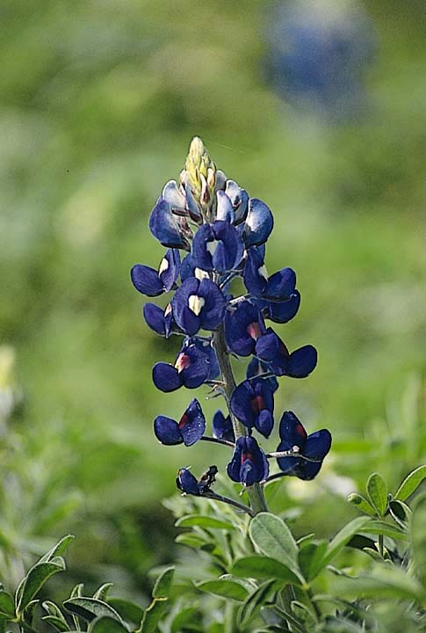
Texas Bluebonnets
  2 soil types (green fill), 3 fertilizer types (outline)
  every combination 5 times
  randomly distribute treatment plots throughout our field
F3/S2
F3/S1
F1/S1
F1/S1
F1/S2
F1/S1
F2/S2
F1/S1
F1/S2
F3/S2
F2/S1
F1/S1
F1/S1
F1/S2
F2/S2
F1/S2
F3/S2
F2/S1
F3/S1
F2/S1
F3/S1
F3/S2
F1/S2
F1/S2
F1/S1
F2/S2
F1/S1
F2/S2
F3/S2
F2/S1
F3/S1
F2/S2
F3/S1
F2/S1
F1/S2
F1/S1
F1/S2
F1/S1

Slide 14
Switch to ze code!

